Slide 1

PRESENTATION ON
<<SALESFORCE>>
SUBMITTED BY
UNIVERSITY ROLL NO :- 1900290140010
NAME :- ARYA MISHRA
SEMESTER :- VI SEMESTER
SECTION :- A
DATE :- 05/03/22

Slide 2
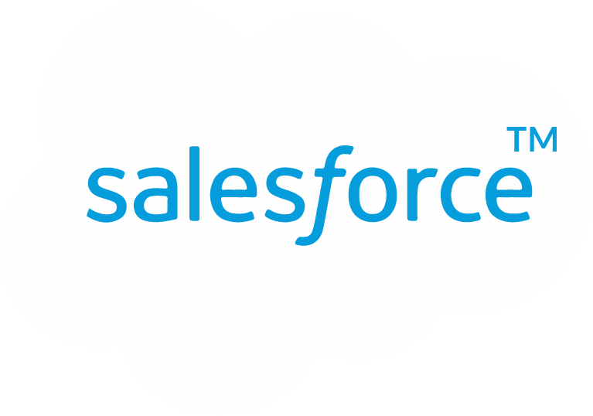

What Is Salesforce?
Salesforce CRM provides a complete solution for that includes feature-rich solutions for marketing, sales, services, partner management and community management.
CRM is originally software for managing customer interaction, such as scheduling tasks, emailing, texting, and many more.
Salesforce grew into a cloud software solution and acquired several other companies for Paas(Platform as a Service) and Saas (Software as a Service).

Slide 3
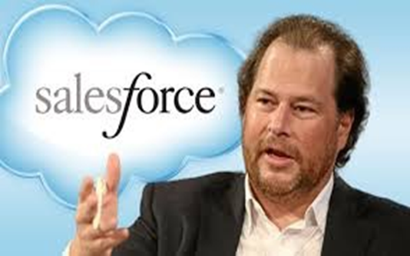
History & Founder
Founder Marc Benioff (1964)
Salesforce is the worlds' first and most popular CRM system .
The headquarter of Salesforce is situated in San Francisco.
More than 82,000 companies and many customers used this dynamic, web-based, low-cost CRM platform.
It was founded in March 1999 by former Oracle executive Marc Benioff.
Salesforce.com has its services translated into 16 different languages and currently has 82,400 regular customers and over 2,100,000 subscribers.

Slide 4
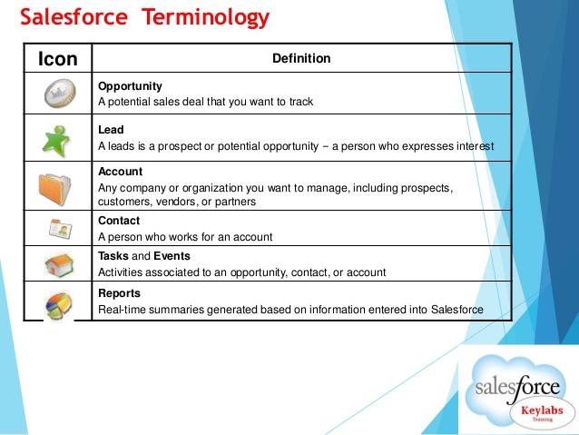
Important Points to Remember

Slide 5
Basics of Salesforce
Objects - Objects are database tables that allow us to store data specific to the organization in salesforce. There are two types of objects.
Standard Objects - The objects provided by salesforce.com is called standard objects. Examples of standard objects are accounts, contacts etc.
Custom Objects - The objects created by us are called custom objects. Custom objects store information that is unique and important to your organization.
Fields - In object database tables fields are the columns. Every standard and custom object has fields attached to it.
Records - In object database tables records are the rows. Records are the actual data associated with an object.

Slide 6
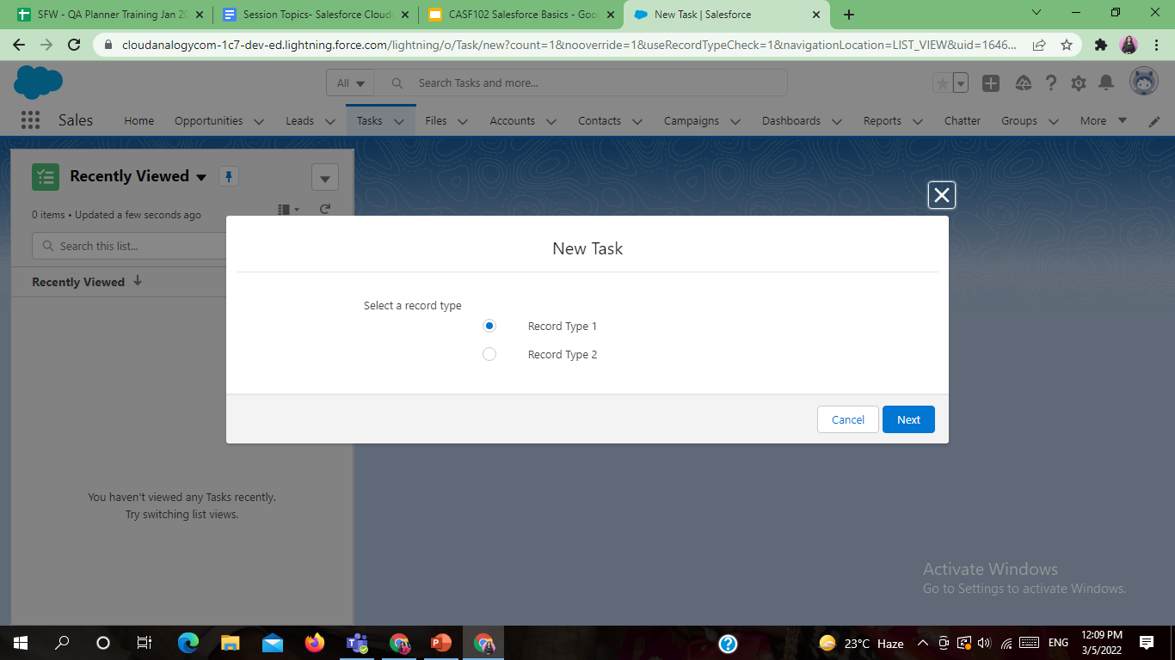
Record Type - Record types let you offer different business processes, picklist values, and page layouts to different users. You might create record types to differentiate your regular sales deals from your professional services engagements, offering different picklist values for each.

Slide 7
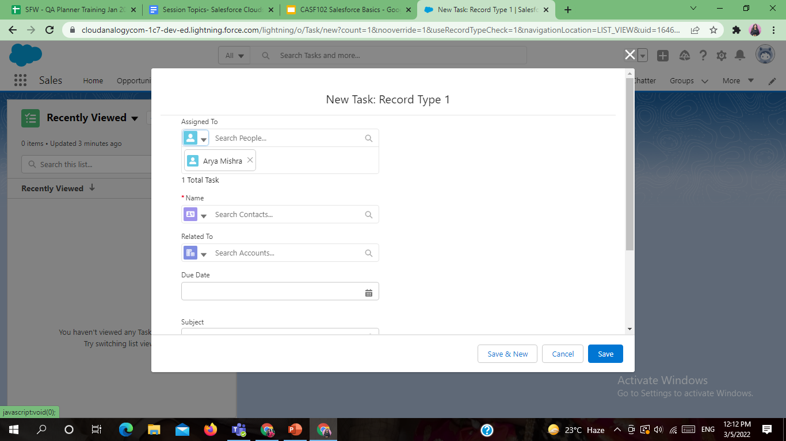
Page Layout - Page Layout in Salesforce allows us to customize the design and organization of detail and edit pages of records in Salesforce. Page layouts can be used to control the appearance of fields, related lists, and custom links on standard and custom object's detail and edit page.

Slide 8
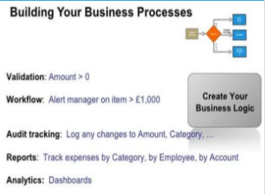
Salesforce Tools
Standard and custom objects
Standard and custom fields
Layouts and record types
Roles and profiles
Validation rules
Workflow and Approvals
Process builders
Tabs, Apps and package

Slide 9
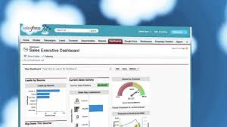
Salesforce Analytics
Reports
Dashboards

Slide 10
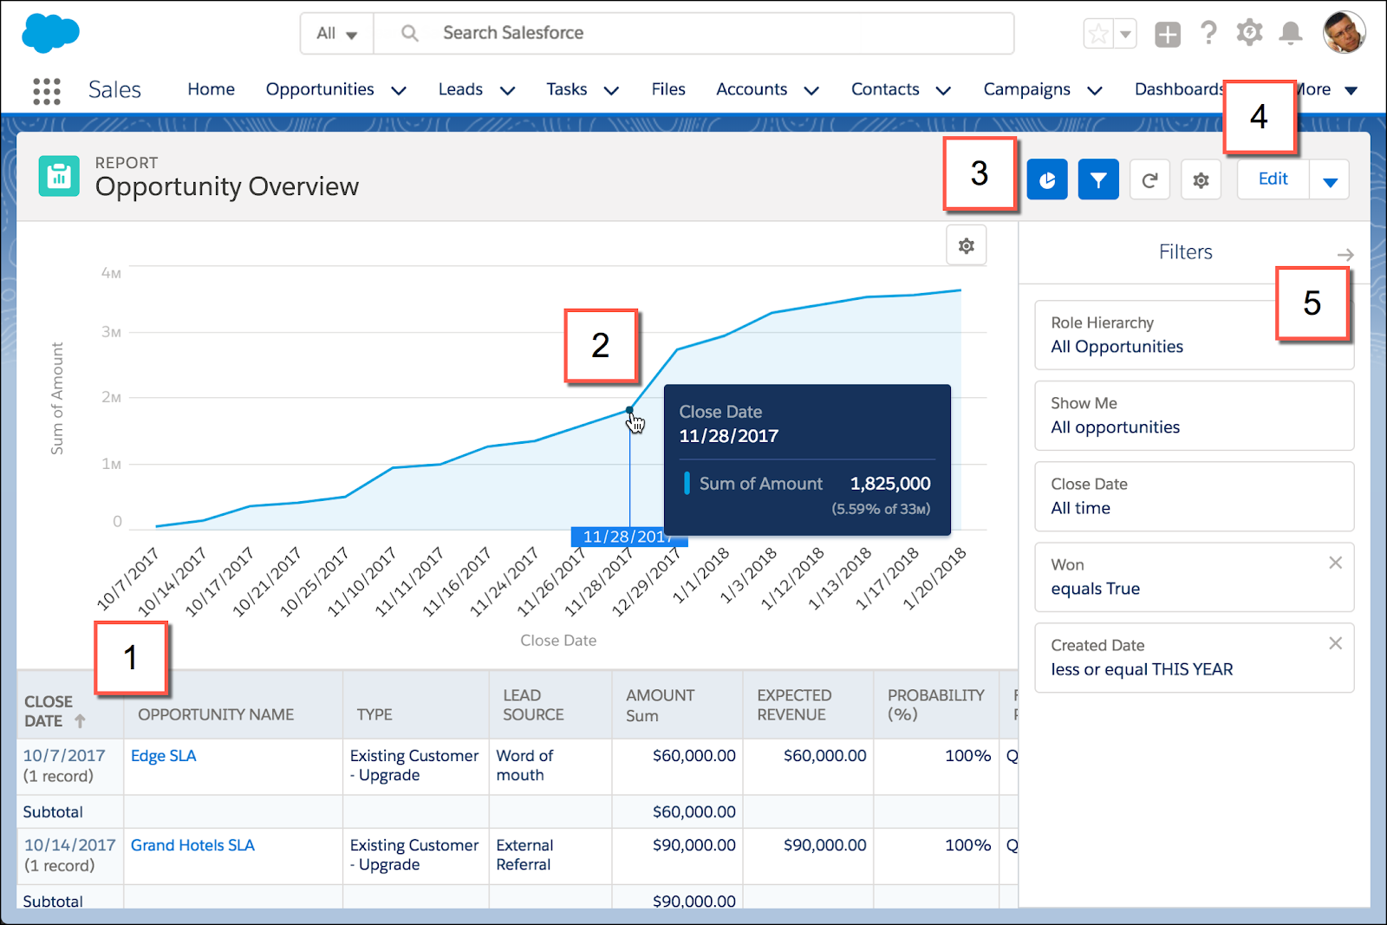
Reports
A report is a list of records that meet the criteria you define. It’s displayed in Salesforce in rows and columns, and can be filtered, grouped, or displayed in a graphical chart.

Slide 11
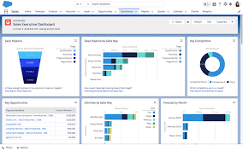
Dashboards
Dashboards are the graphical representations of the results from the reports

Slide 12
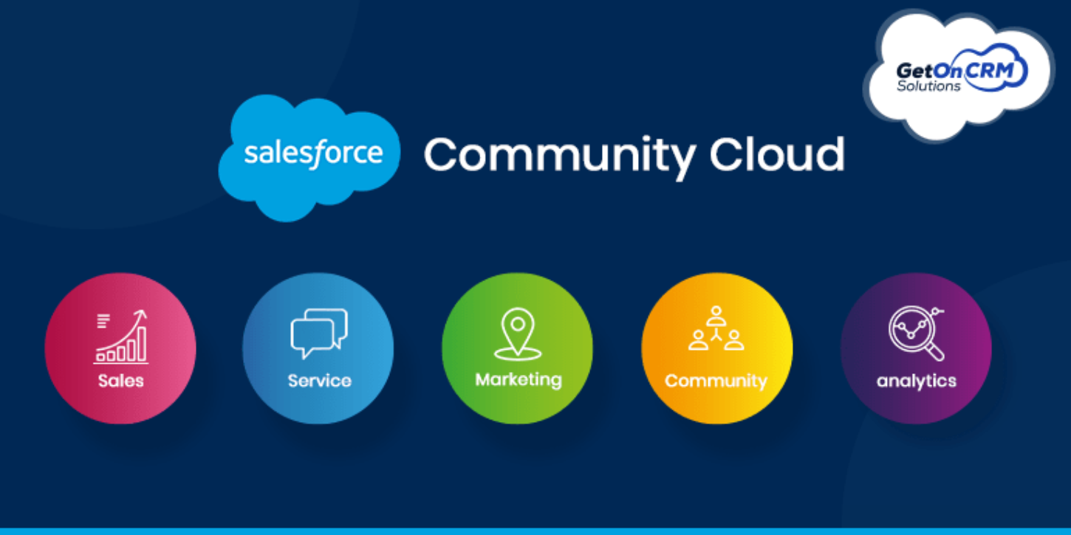
Clouds in Salesforce
Sales Cloud
Service Cloud
Marketing Cloud
Commerce Cloud
Community Cloud

Slide 13
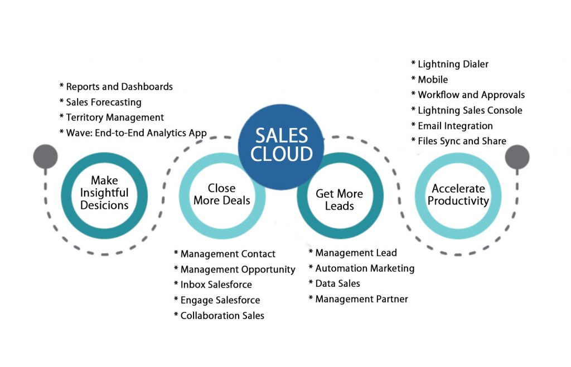
Sales Cloud
Salesforce Sales Cloud helps to build a stronger relationships with customers. It is a cloud-based CRM platform that keeps information about leads, customers and sales all in one place.

Slide 14
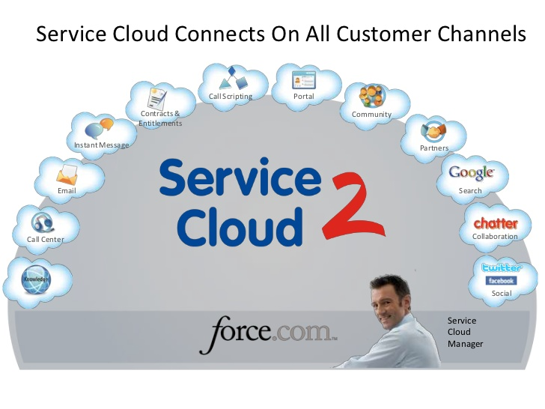
Service Cloud
Salesforce offers Service cloud that provides customer services. It is a cloud that supports customers on any channel, at any time, at scale.

Slide 15
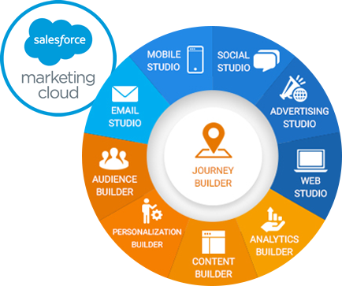
Marketing Cloud
It enables you to know your customer, personalize with intelligence, and engage across the entire journey.

Slide 16
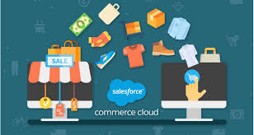
Commerce Cloud
Salesforce offers e-commerce solutions for B2C (business to consumer) and B2B (business to business) customers to provides the best e-Commerce websites to their customers who are shopping online.

Slide 17
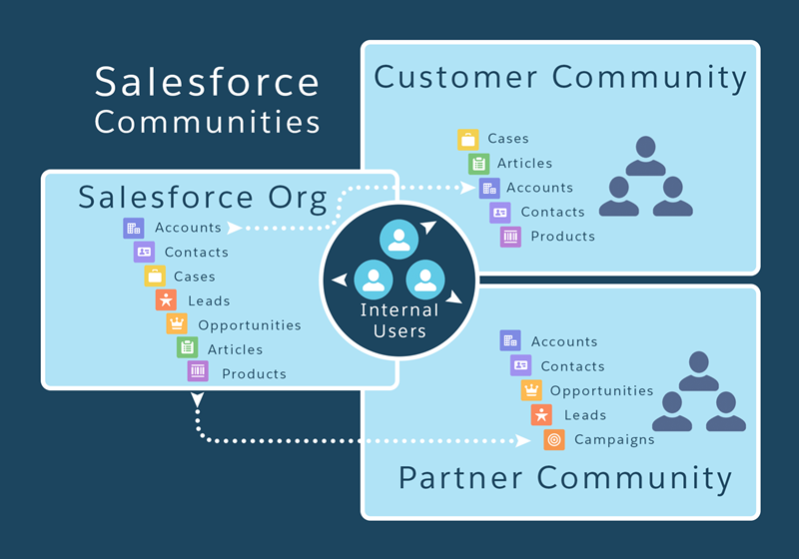
Community Cloud
Whether you call it a portal, a help forum, a support site, or something else, a community is a beautifully branded digital experience connected to your CRM. Community Cloud makes it easy to create these experiences, engage customers, and empower partners.

Slide 18
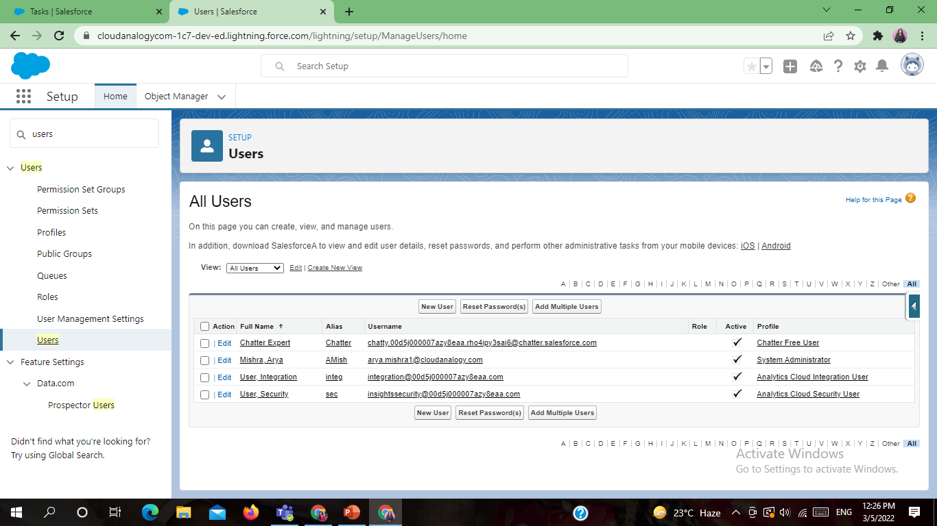
Users, Roles and Profiles
Users - A user is anyone who logs in to Salesforce. Users are employees at your company, such as sales reps, managers, and IT specialists, who need access to the company's records. Every user in Salesforce has a user account.

Slide 19
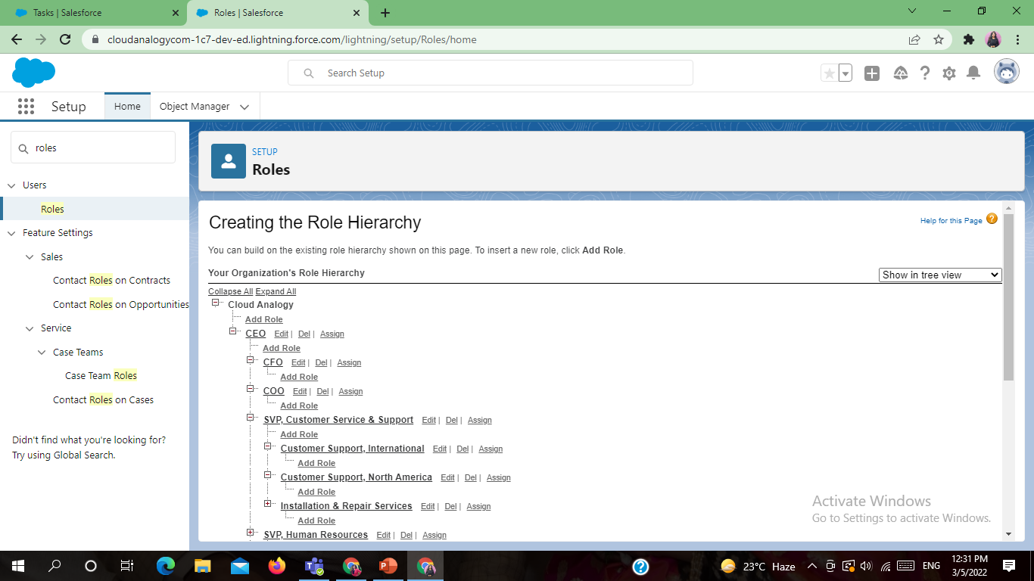
Roles and Role Hierarchy - Role and its hierarchy is a mechanism to control the data access to the records on a salesforce object based on the job role of a user. For example, a manager needs to have access to all the data pertaining to the employees who report to him, but the employees have no access to the data that is only owned by their manager.

Slide 20
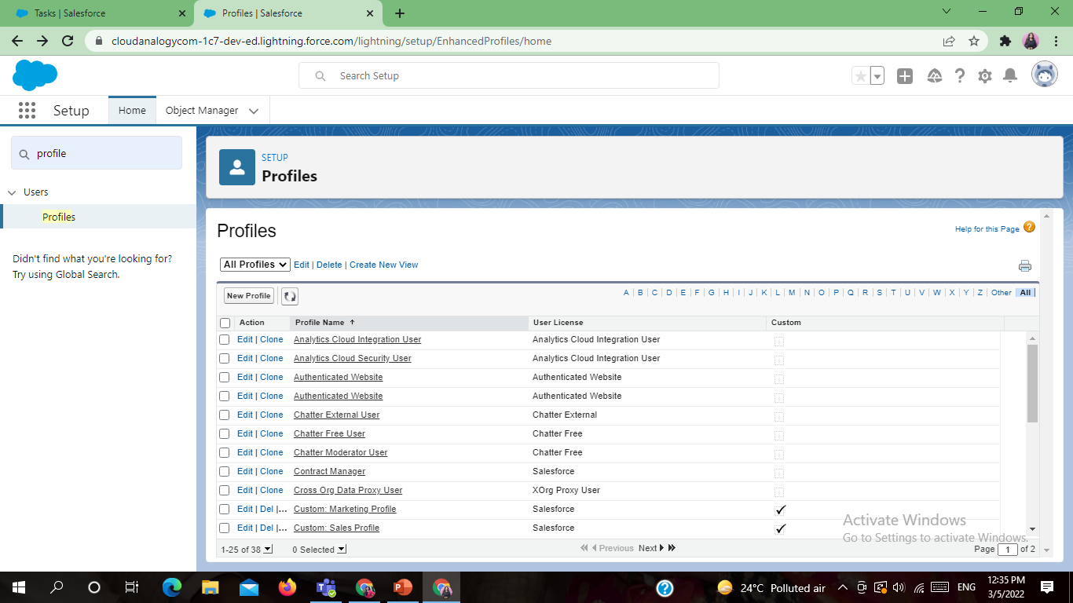
Profile - Salesforce profile is a set of settings and permissions provided to specific Salesforce users that define the extent of their actions on the platform. A profile in Salesforce determines the way in which users can access objects and data to perform specific business processes

Slide 21


